Slide 1
Presenting at the ATA Conference
Tianlu Redmon
For HITA Annual Meeting on Feb. 23, 2019

Slide 3
Proposal
Conference Sessions: Thursday - Saturday, 1-2hr
AST Courses: Wednesday, October 23, 3hr
March 1, 2019
ATA60: October 23-26, 2019 Palm Springs, CA
https://tools.eventpower.com/speaker_management/index/19ATA-ANNUAL
https://www.youtube.com/watch?v=LkiVHH7RcSw

Slide 4
Proposal
http://www.atanet.org/conf/2018/sessions/

Slide 5
Preparation
Speaker Zone
Prepare ahead of time
Practice and track time
Upload and print handout: early September

Slide 8
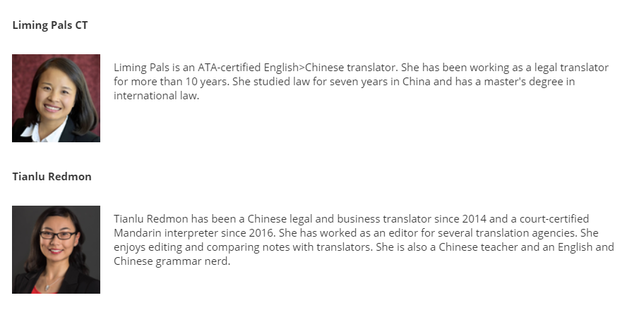

Slide 9
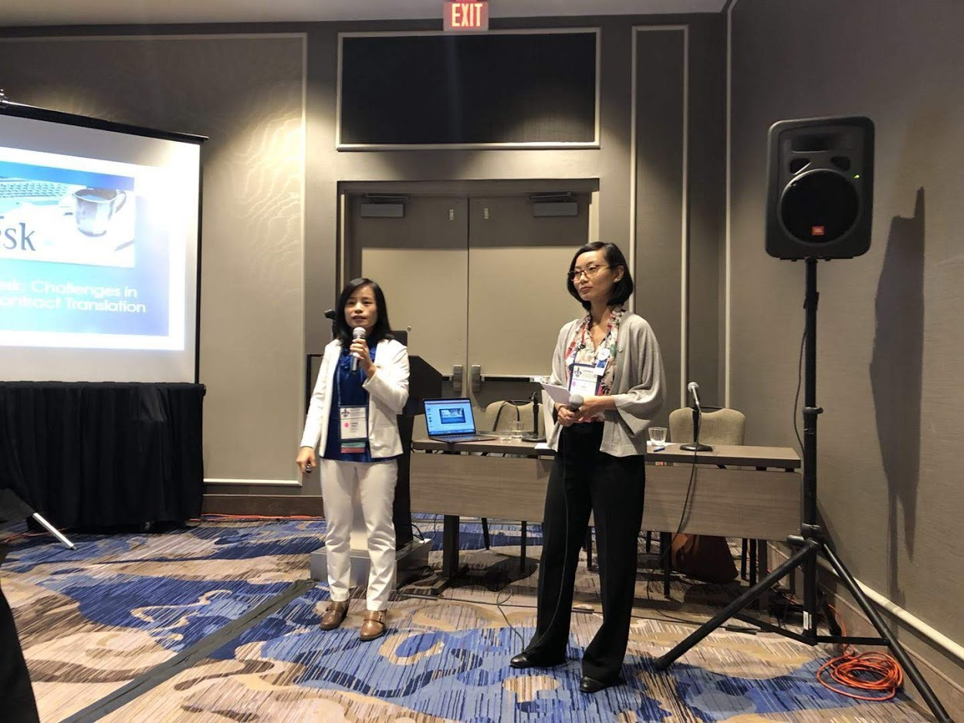
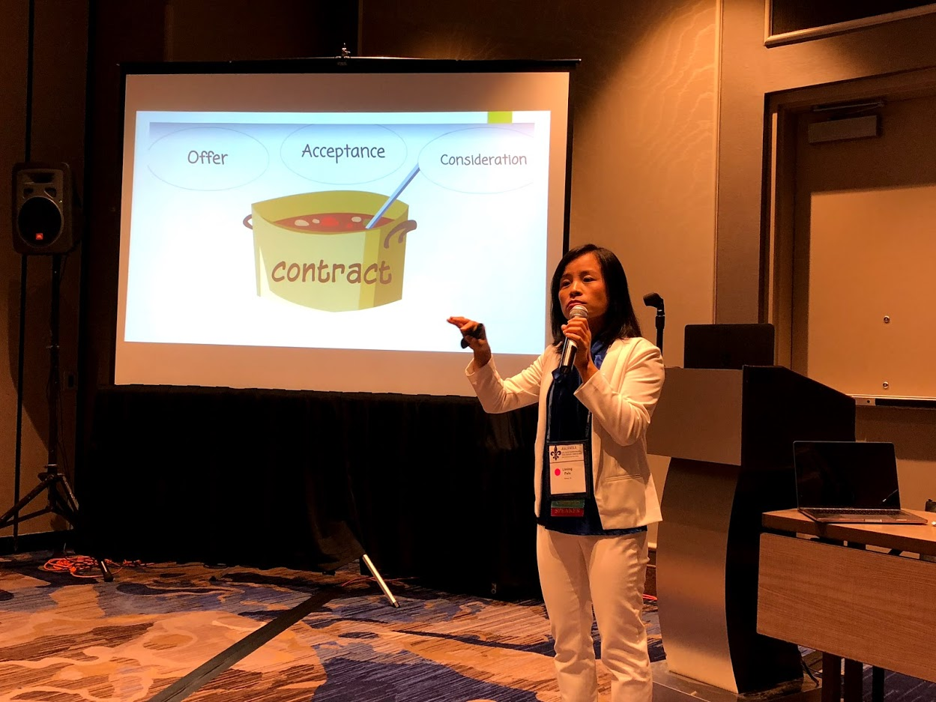

Slide 10
First Conference?

Slide 11
Networking Tips
Business cards
Dress for success
Conference app
http://www.ata-conf-newbies.org/

Slide 12
https://atasavvynewcomer.org/

Slide 13
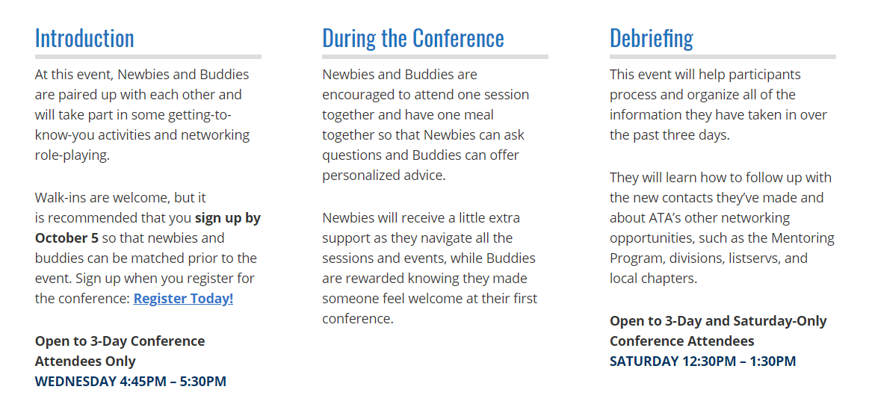
BUDDIES WELCOME NEWBIES

Slide 14
ATA59 Highlight
https://youtu.be/1k6roPdU2dk

Slide 15
Questions? Feel free to reach out!
Tianlu Redmon
ATA-Certified English > Chinese Translator
Master Court Interpreter in Texas
Conference Interpreter for Mandarin
832.942.2008
Tianlu@TianluChinese.com

