Slide 1
Career Outlook in Translation and Interpreting
takeaways from the ATA59 Conference,
New Orleans, 2018
Veronika Demichelis, CT, MA, MBA
HITA Annual General Meeting
February 23, 2019

Slide 2
A Brave New World of Career Possibilities for Linguists
Winnie Heh
Career Advisor for the translation, interpreting, and localization management MA programs at the Middlebury Institute of International Studies at Monterey (MIIS)
The Eco-System of Language Profession
Link: http://winnieheh.middcreate.net/wiki/doku.php

Slide 3
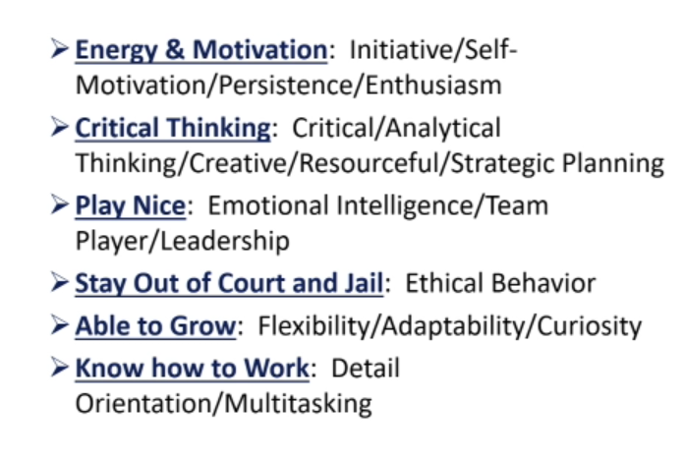
Soft Skills
IQ gets you hired, EQ gets you promoted

Slide 4
Future Tense: How Artificial Intelligence and Neural Machine Translation Are Shaping Our Industry
Jay Marciano, Director of Machine Translation at Lionbridge Technologies

Slide 5
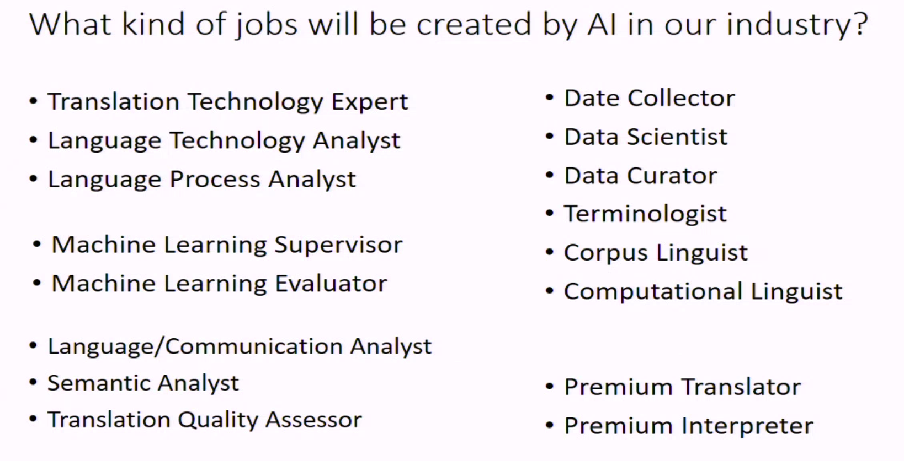
Future Tense (cont.)
“Future Tense: How Artificial Intelligence and Neural Machine Translation Are Shaping Our Industry”, Jay Marciano, ATA59

Slide 6
Learn more
ATA59 Virtual Conference is available online
$79 (ATA members) and $129 (Non-members)
http://www.atanet.org/conf/2018/virtual/
The Virtual Conference is approved for ATA Continuing Education Points.
Earn one point for each hour viewed, up to a maximum of 10 points.

